Slide 1
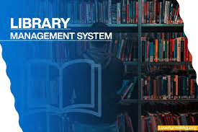
BY:
Gopal Matcha(032)
Sai Kishore Bandari(044)
Tanish Rohil Gali(056)

Slide 2
Introduction
The project titled Library Management System is software for monitoring and controlling the transactions in a library. The project “Library Management System” is developed in python, which mainly focuses on basic operations in a library like adding new member, new books, updating new information, searching books, searching members , facility to borrow and return books.
Software is easy to use for both beginners and advanced users. It features a familiar and well thought-out, an attractive user interface.
This system excludes the use of paper work by managing all the book information electronically.

Slide 3
SYSTEM ANALYSIS: System analysis is a detailed study of the various operations performed by a system and their relationships within and outside of the system. A good analysis model should provide not only the mechanisms of problem understanding but also the frame work of the solution. Thus, it should be studied thoroughly by collecting data about the system. Then the proposed system should be analyzed thoroughly in accordance with the needs.
EXISTING SYSTEM:
In existing system, all the transaction of books are done manually. So, it takes a lot of time for a transaction like borrowing a book or returning a book and also for searching a book.
Another major disadvantage is that to preparing the list of books borrowed and the available books in the library will take more time
Although, the prepared list of books and fines is vulnerable to Human Error.
So , after conducting the feasibility study we decided to make the manual Library management system to be computerized.

Slide 4
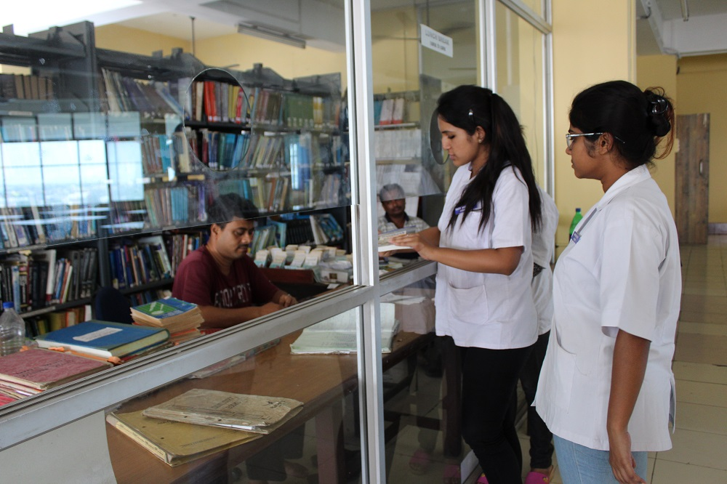
DISADVANTAGES:
Since, all the transactions of books are done manually, a lot of time is taken
Searches Take Longer and Are Less Efficient
Vulnerability to Human Error
Costs Add Up Over Time
Geographical Limitations
It is not unavailable, round the clock (24/7)
The image shows the existing system (manual library system)

Slide 5
Proposed system:
FEASIBILITY ANALYSIS:
Whatever we think need not be feasible. It is wise to think about the feasibility of any problem we undertake. Feasibility is the study of impact, which happens in the organization by the development of a system. The impact can be either positive or negative. When the positives nominate the negatives, then the system is considered feasible.
The impact that an alternate computerized system can be either positive or negative. When the positives dominate the negatives, then the system is considered feasible.
Proposed system is an automated Library Management System.
Through our software user can add members, add books, search books, update information, edit information, borrow books, return books and check the fines in quick time.
Here the feasibility study can be performed in two ways such as:
Technical feasibility
Economical Feasibility.

Slide 6
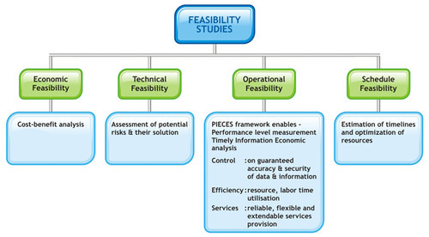
TECHNICAL FEASIBILITY:
We can strongly say that it is technically feasible, since there will not be much difficulty in getting required resources for the development and maintaining the system as well. All the resources needed for the development of the software as well as the maintenance of the same is available in the organization here we are utilizing the resources which are available already.
ECONOMICAL FEASIBILITY:
Development of this application is highly economically feasible. The only things to be done is making an environment for the development with an effective supervision. If we are doing so, we can attain the maximum usability of the corresponding resources. Therefore, the system is economically feasible.
Hence, from the above analysis it is clear that the computerized library system is thoroughly feasible.
Image shows different kinds of
feasibility analysis and their importance

Slide 7
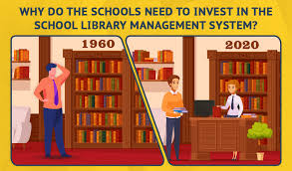
ADVANTAGES OF PROPOSED SYSTEM:
Our proposed system has the following advantages:
User friendly interface
Greater Accuracy in maintaining records
More Storage Capacity
Search facility
Quick transaction
All the manual difficulties in managing the Library have been rectified by implementing computerization
Highly Secure, Scalable & Reliable
Image shows the difference between manual and computerized library system

Slide 8
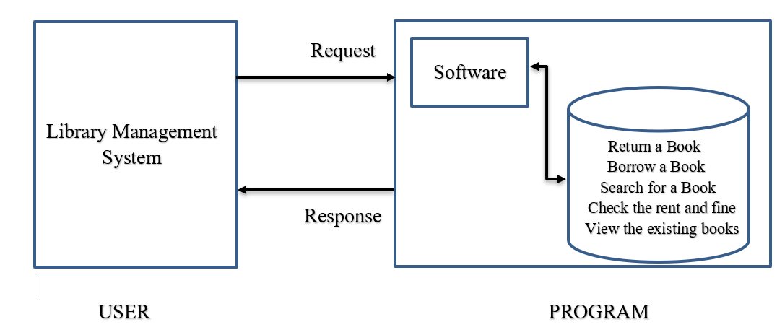
DATA FLOW DIAGRAM:
ARCHITECTURE OF PROPOSED SYSTEM:
User
System
Result

Slide 9
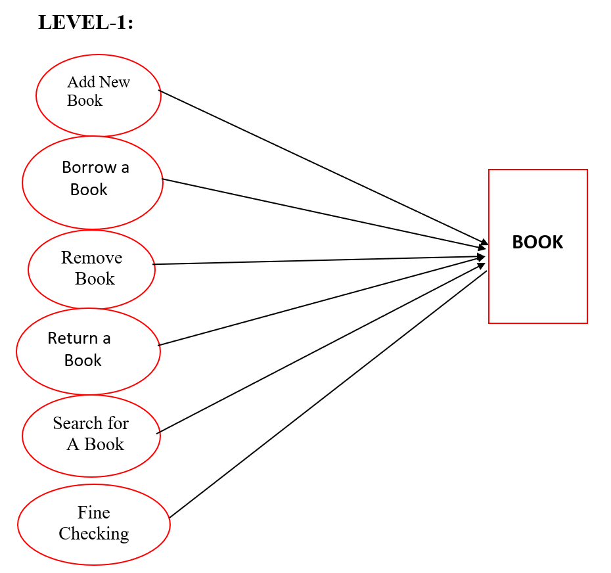
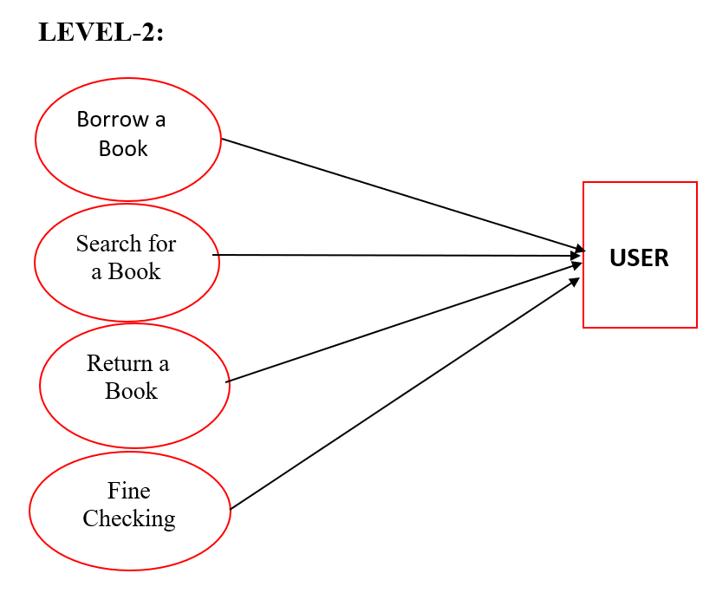
Fig 1.1
Fig 1.2
* Fig 1.1 represents various tasks that can be done using this system.
Fig 1.2 represents various ways in which the system can be used by the user

Slide 10
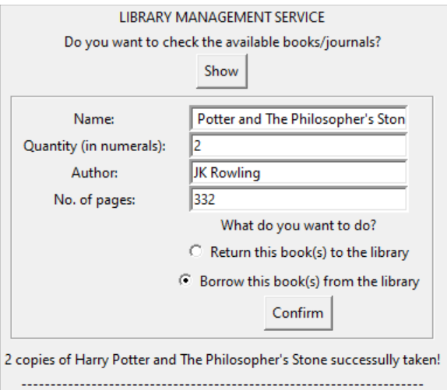
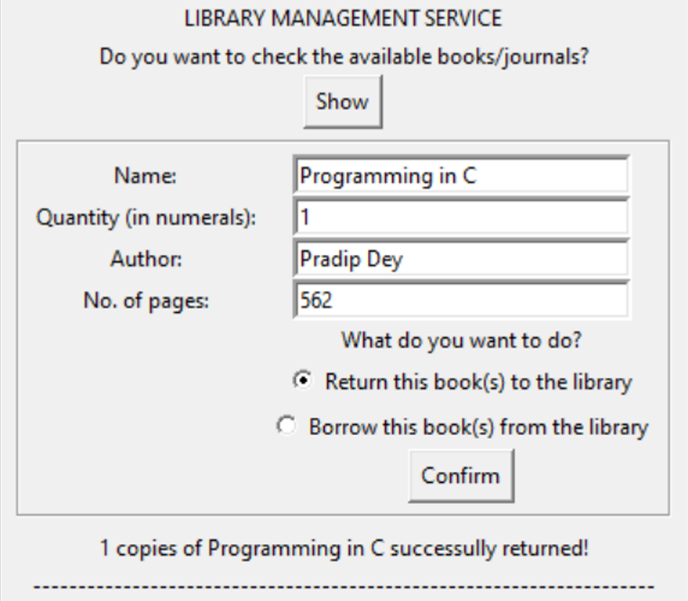
SOFTWARE INTERFACE:
1. Borrowing a Book:
2. Returning a Book:

Slide 11
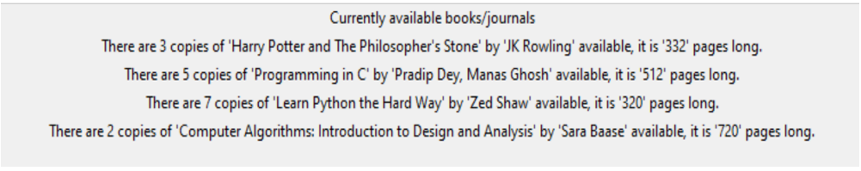
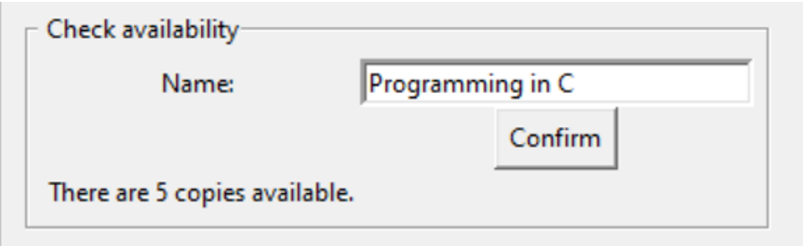
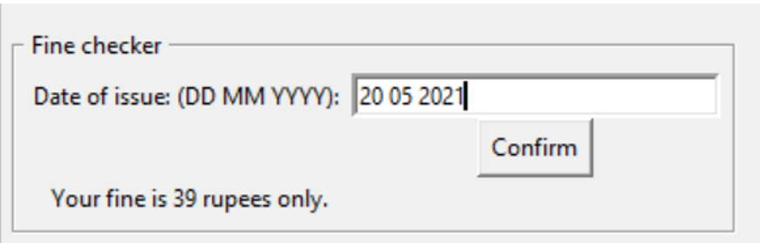
3.Displaying the available Books:
4. Searching for a Book:
5.Checking the fine(if applicable):

Slide 12
Modules Required:
Tkinter(*):
Tkinter is the standard GUI library for Python. Python when combined with Tkinter provides a fast and easy way to create GUI applications. Tkinter provides a powerful object-oriented interface to the Tk GUI toolkit.
Datetime (date):
Datetime module supplies classes to work with date and time. These classes provide a number of functions to deal with dates, times and time intervals.
libDatabase(*):
A database is an abstraction over an operating system’s file system that makes it easier for developers to build applications that create, read, update and delete persistent data.
SQLite3:
SQLite3 is a very easy to use database engine. It is self-contained, serverless, zero-configuration and transactional. … The Python Standard Library includes a module called “sqlite3" intended for working with this database. This module is a SQL interface compliant with the DB-API 2.0 specification.

Slide 13
REQUIREMENTS
HARDWARE CONFIGURATION
Processor : Intel Core i7-5960X or Above RAM : 128 MB Hard Disk : 20GB Monitor : Color monitor
SOFTWARE CONFIGURATION
Language : Python Software Platform : Python 3.8(64-bit) or above Database : MySQL Setup tools and pip to be installed for 3.6.x and above

Slide 14

Conclusion
The Library Management System allows the user to store the book details .
This software allows storing the details of all the data related to library.
The implementation of the system will reduce data entry time and provide readily calculated reports.
Image shows the usage of The Library Management System Software

Slide 15
FUTURE SCOPE OF APPLICATION:
This application can be easily implemented under various situations. We can add new features as and when we require. Reusability is possible when required in this application. There is flexibility in all the modules.
SOFTWARE SCOPE:
Extensibility: This software is extendable in ways that its original developers may not expect. The following principles enhances extensibility hiding a data structure, avoid traversing multiple links or methods, avoid case statements on object type and distinguish public and private operations.
Reusability: Reusability is possible as and when require in this application. We can update it to the next version. Reusable software reduces design, coding and testing cost by amortizing effort over several designs. Reducing the amount of code also simplifies understanding, which increases the likelihood that the code is correct.
Understandability: A method is understandable if someone other than the creator of the method can understand the code (as well as the creator after a time lapse). We use the method, which small and coherent helps to accomplish this.
Cost-effectiveness: Its cost is under the budget and make within given time period. It is desirable to aim for a system with a minimum cost subject to the condition that it must satisfy the entire requirement. Scope of this document is to put down the requirements, clearly identifying the information needed by the user, the source of the information and outputs expected from the system.

